Slide 1


CITS1003 Introduction to Cybersecurity [7] Incidents exercises
Dr Zhi Zhang

Slide 2
Automation
CALDERA
ADTool

Slide 3
CALDERA
cyber range simulates real-world network environment that can be used to replicate real-world cyber scenarios.
red team is a group of security professionals who simulate cyber attacks and thus identify weaknesses that can be exploited by real attackers
blue team is a group of security professionals who respond to the simulated attacks and test their incident responses.

Slide 4
CALDERA
CALDERA provides a cyber-range environment.
A red team can automate simulated attacks that are modelled from real-world threat actors, identify weaknesses in a target organization’s network and test the incident-response mechanisms that are deployed.
A blue team can inspect the effectiveness of their deployed defenses and incident-response mechanisms, thus improving their incident response capabilities, better preparing for real-world cyber threats and mitigating the risks associated with cyber attacks.

Slide 5
CALDERA
Installation
Open a Linux VM
Run the following commands:
sudo apt install python3-pip
git clone https://github.com/mitre/caldera.git --recursive
cd caldera
pip3 install -r requirements.txt
python3 server.py --insecure

Slide 6
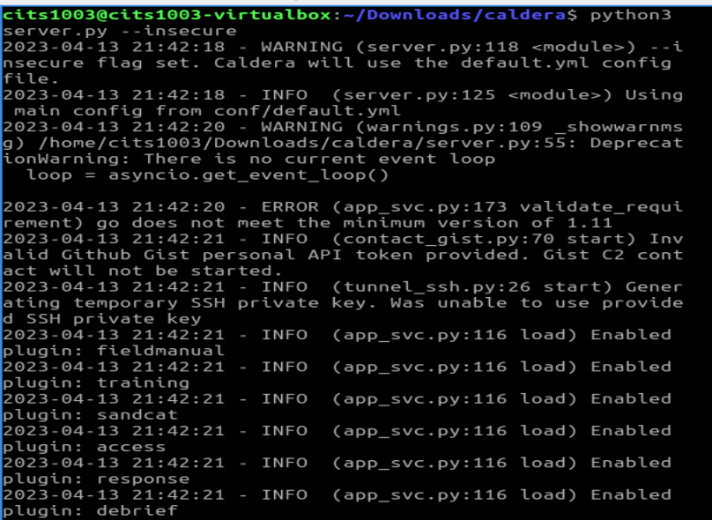
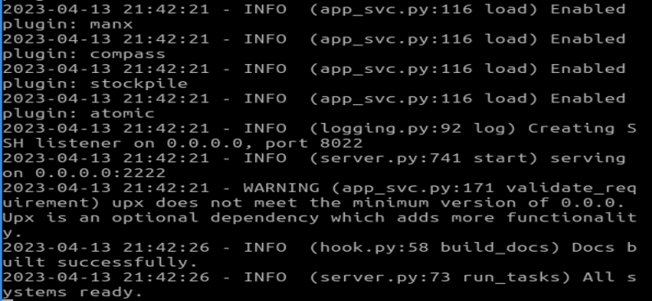

Slide 7
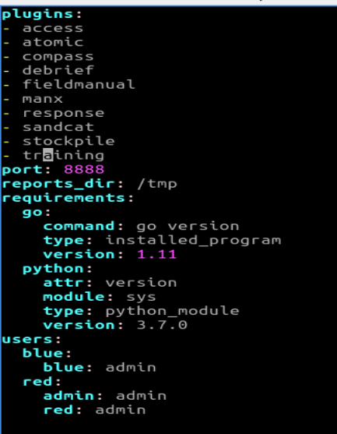
CALDERA
Login
In caldera/conf/default.vml,

Slide 8
CALDERA
Login
Open a browser
Enter the following URL in the address bar
http://localhost:8888
username: red
password: admin

Slide 9
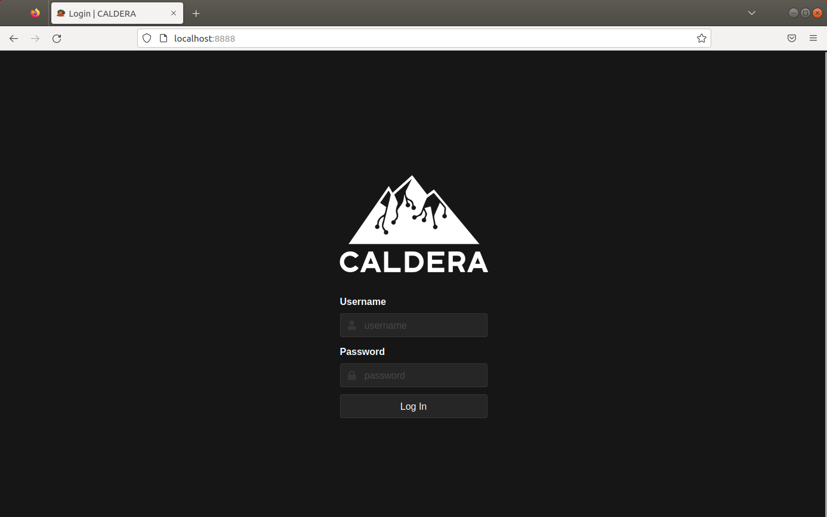
CALDERA

Slide 10
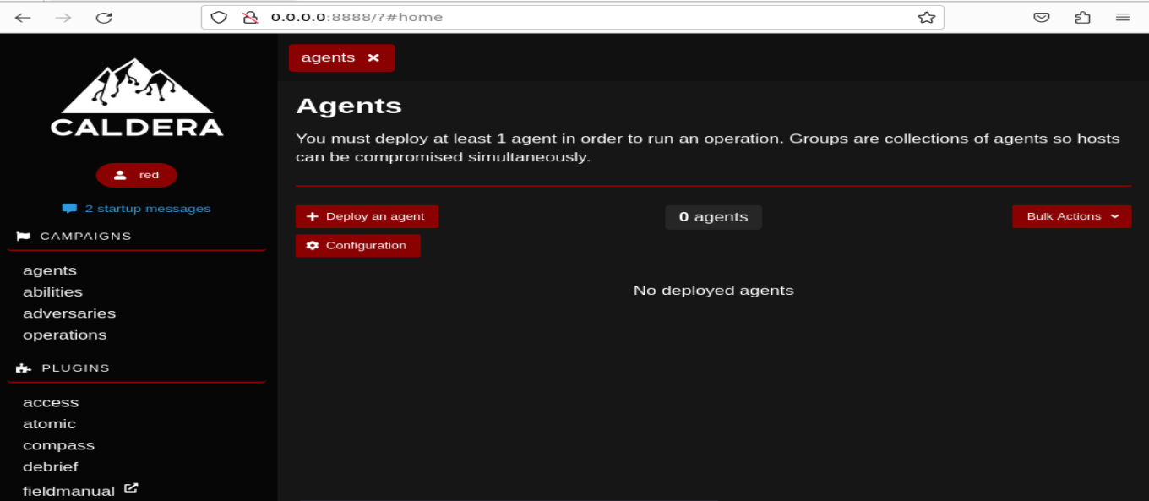
CALDERA

Slide 11
CALDERA
Adversary is a profile of instructions that describe various TTPs (Tactics, Techniques and Procedures) to be performed on a targeted system. An adversary profile can be used to simulate an attack automatically.

Slide 12
CALDERA
Tactic: high-level attack goal that attackers aim to achieve.
e.g., gaining unauthorized access.
Technique: specific method used by attackers to achieve a tactic.
e.g., exploiting vulnerabilities.
Procedure: step-by-step process followed by attackers when executing a technique.
e.g., specific commands in each step.

Slide 13
CALDERA
Adversary is a profile of instructions that describe various TTPs to be performed on a targeted system. An adversary profile can be used to simulate an attack automatically.
Agent works as a spy program that is installed on the targeted system and responsible for executing TTPs specified in the adversary profile.

Slide 14
CALDERA
Adversary is a profile of instructions that describe various TTPs to be performed on a targeted system. An adversary profile can be used to simulate an attack automatically.
Agent works as a spy program that is installed on the targeted system and responsible for executing TTPs specified in the adversary profile.
Ability is a specific implementation of a tactic/technique including what commands to run and what OS the commands can run on.
e.g., display information about running processes in Linux by running ``ps –aux”

Slide 15
CALDERA
Adversary is a profile of instructions that describe various TTPs (tactics, techniques and procedures) to be performed on a targeted system. An adversary profile can be used to simulate an attack or evaluate the effectiveness of a security defense.
Agent works as a spy program that is installed on the targeted system and responsible for executing TTPs specified in the adversary profile.
Ability is a specific implementation of a tactic/technique including what commands to run and what OS the commands can run on.
Operation is to create an adversary profile and execute the profile via agent.

Slide 17
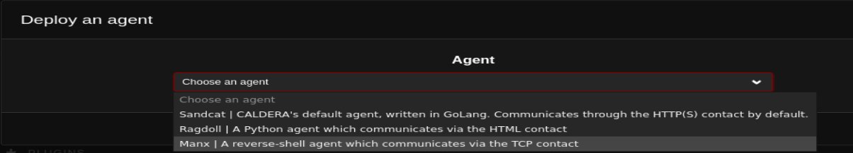

Slide 18
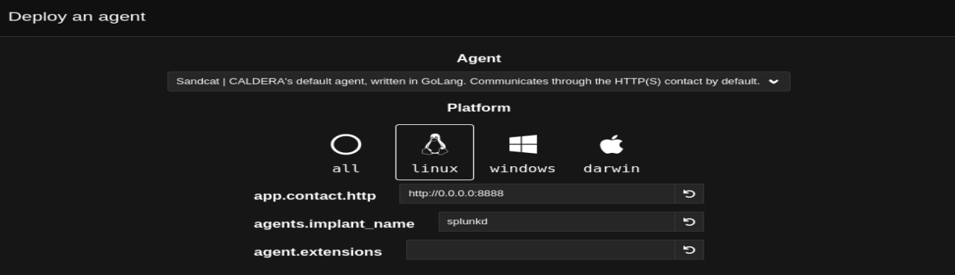
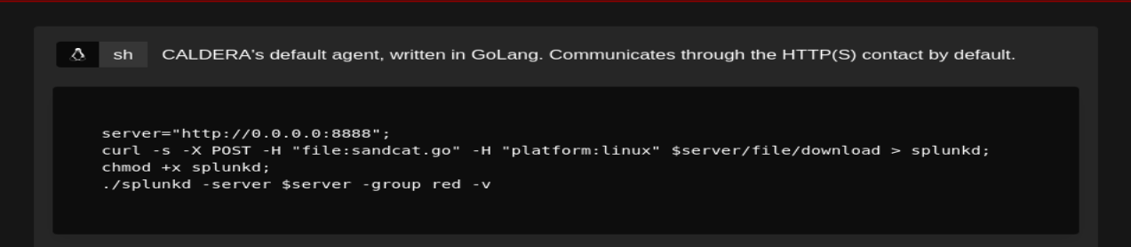

Slide 19

chmod +x agent.sh

Slide 20
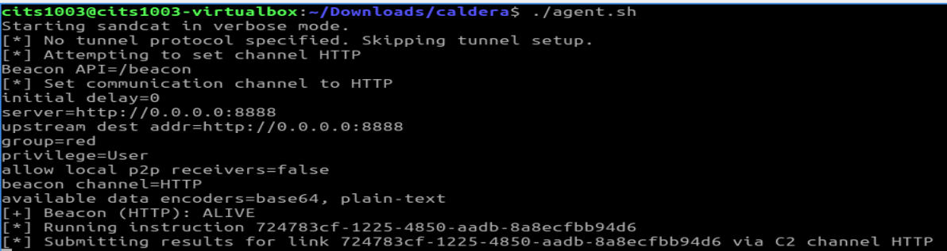

Slide 21
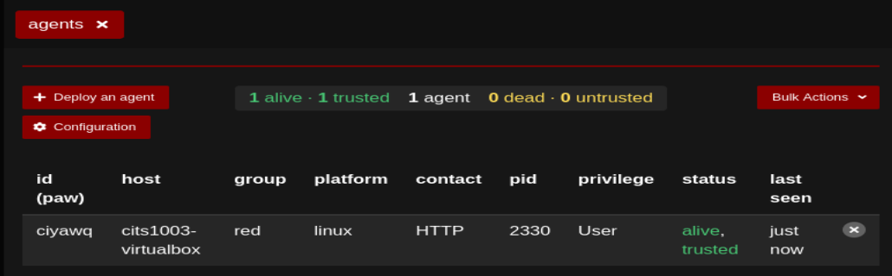

Slide 22
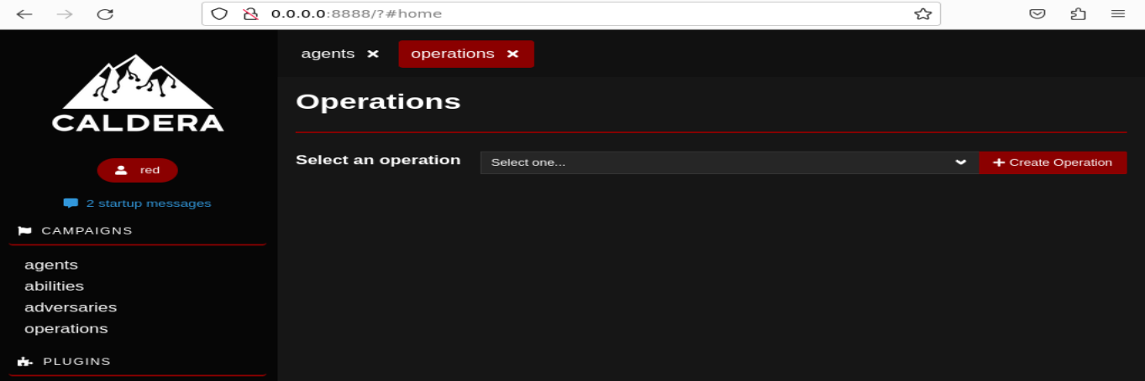

Slide 23
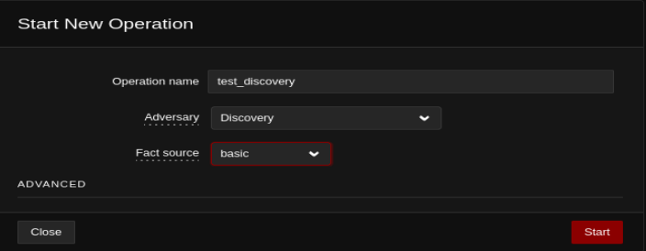

Slide 24
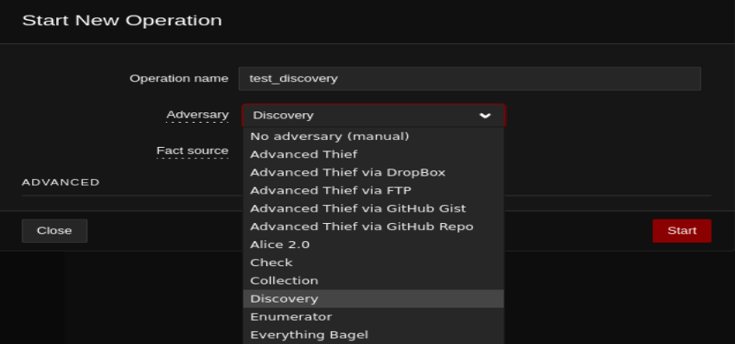
https://caldera.readthedocs.io/en/latest/plugins/stockpile/Exfiltration-How-Tos.html

Slide 25
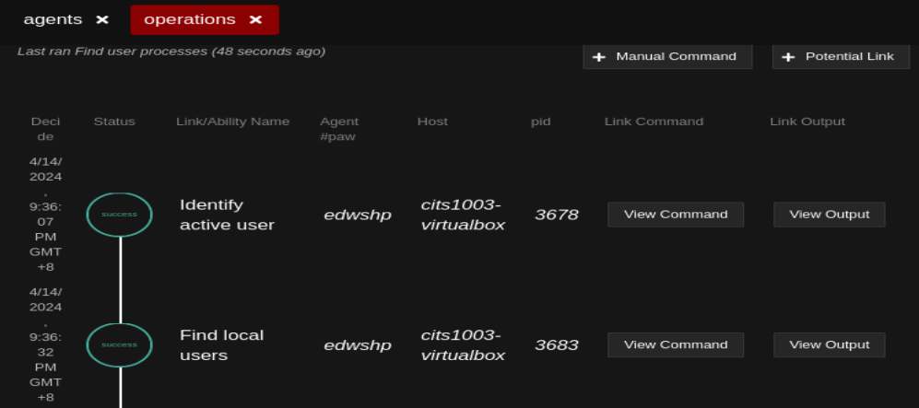

Slide 26
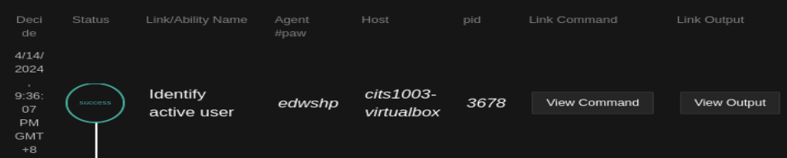
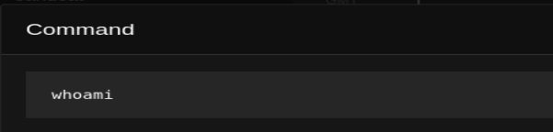
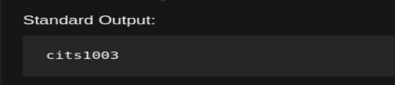

Slide 27
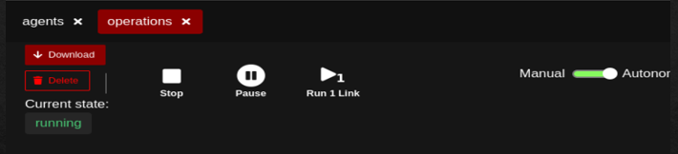
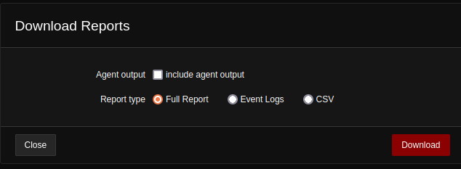

Slide 28
CALDERA
Demo

Slide 29
ADTool
What is ADTool?
ADTool, short for Attack-Defense Tree Tool, allows a user to model and analyze attack-defense scenarios using attack-defense trees.

Slide 30
ADTool
Installation
In a windows OS, download JDK (Java Development Kit):
Filename: jdk-17_windows-x64_bin.exe
https://www.oracle.com/java/technologies/downloads/
Install JDK
Double click the exe file

Slide 31
ADTool
Installation
Download JDK
Install JDK
Download ADTool: https://satoss.uni.lu/members/piotr/adtool/
Filename: ADTool-1.4-jar-with-dependencies.jar

Slide 32
ADTool
Installation
Download JDK
Download ADTool
Run the tool
Open PowerShell from the directory where the tool is downloaded
Run this command: java –jar .\ADTool-1.4-jar-with-dependencies.jar

Slide 33
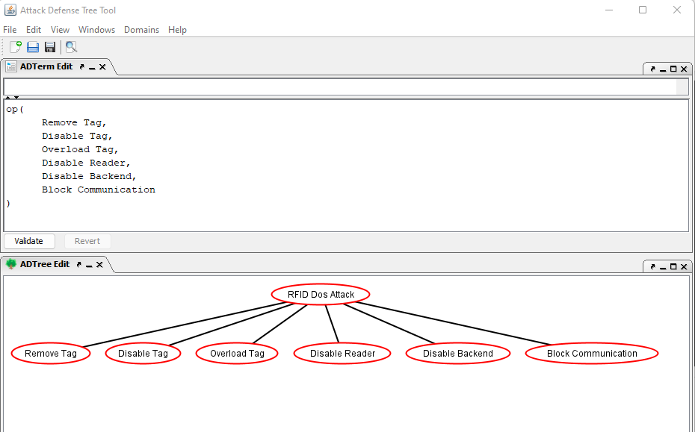

Slide 34
or proponents

Slide 35
or proponents
or
proponents

Slide 37
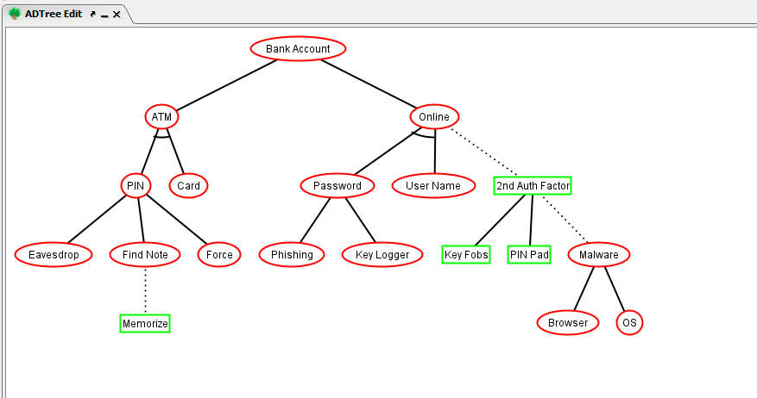
or proponents
op
op
op

Slide 38
op: or proponents
ap: and proponents
ap
?
op
op
?
?
op
?

Slide 39
op: or proponents
ap: and proponents
ap
?
opponent
op
op
oo: or opponents
?
opponent
opponent
op
?
opponent

Slide 40
op: or proponents
ap: and proponents
ap
cp
opponent
op
op
oo: or opponent
co: counter opponent
opponent
opponent
op
cp: counter proponent
opponent

Slide 41
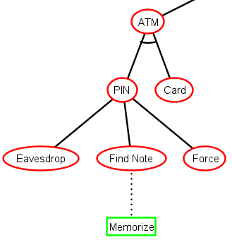
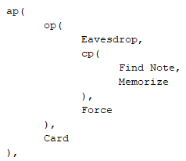

Slide 42
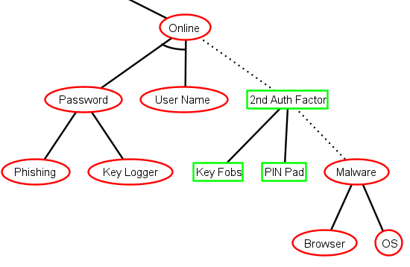
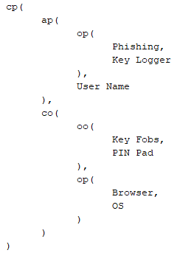

Slide 43
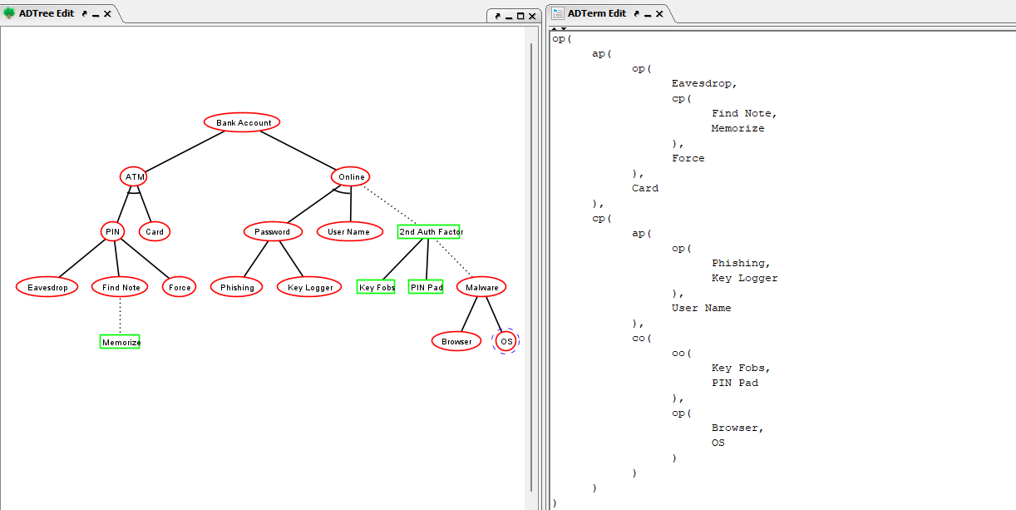

Slide 44
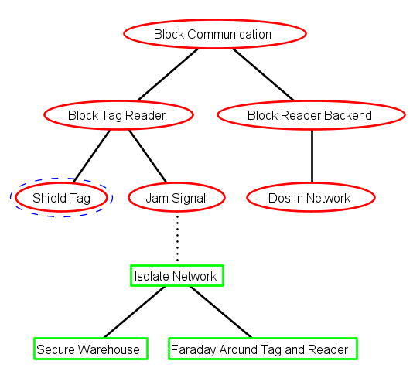
Exercise (tree translation)

Slide 45
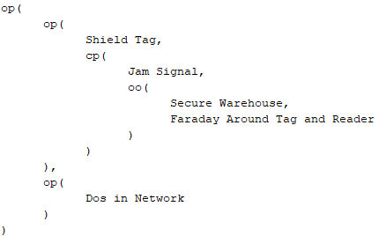
Exercise (tree translation)

Slide 46
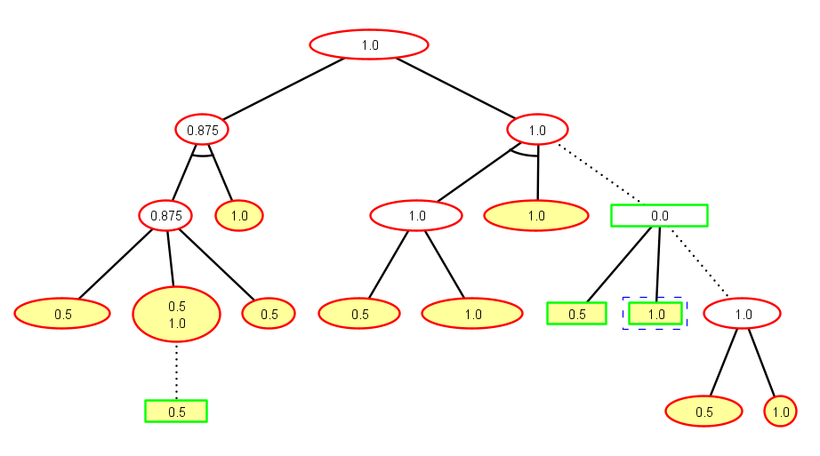
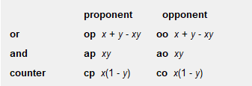
Exercise (success probability for the nodes)
0.75
1.0
0.0
1.0
0.5

Slide 47
Exercise (success probability for the nodes)
0.75
1.0
0.0
1.0
0.5

Slide 48
Exercise (success probability for the nodes)
0.75
1.0
0.0
1.0
0.5

Slide 49
Exercise (success probability for the nodes)
0.75
1.0
0.0
1.0
0.75
0.5

Slide 50
Exercise (success probability for the nodes)
0.75
1.0
0.0
0.75+0.5-0.75*0.5
1.0
0.5

Slide 51
Exercise (success probability for the nodes)
0.75
1.0
0.0
0.75+0.5-0.75*0.5
1.0
0.5

Slide 52
Exercise (success probability for the nodes)
0.75
1.0
0.0
0.75+0.5-0.75*0.5
1.0
0.75
0.5

Slide 53
Exercise (success probability for the nodes)
0.75
1.0
0.0
0.75+0.5-0.75*0.5
1.0
0.75
0.5

Slide 54
Exercise (success probability for the nodes)
0.75
1.0
0.25
0.75+0.5-0.75*0.5
1.0
0.75
0.5

Slide 55
Exercise (success probability for the nodes)
0.75
1.0
0.25
0.75+0.5-0.75*0.5
1.0
0.75
0.5

Slide 56
Exercise (success probability for the nodes)
0.75
1.0
0.25
0.75+0.5-0.75*0.5
1.0
0.75
0.5

Slide 57
Exercise (success probability for the nodes)
0.75
1.0
0.25
0.75+0.5-0.75*0.5
1.0
0.75
0.5

Slide 58
Exercise (success probability for the nodes)
0.875+0.75-0.875*0.75
0.96875
0.75
1.0
0.25
0.75+0.5-0.75*0.5
1.0
0.75
0.5

